Slide 1
Neuromancer: Differentiable Programming Library for Modeling, Optimization, and Control
Power Seminar Series
Washington State University
Ján Drgoňa, Aaron Tuor, James Koch, Madelyn Shapiro, Rahul Birmiwal, Draguna Vrabie

Slide 2

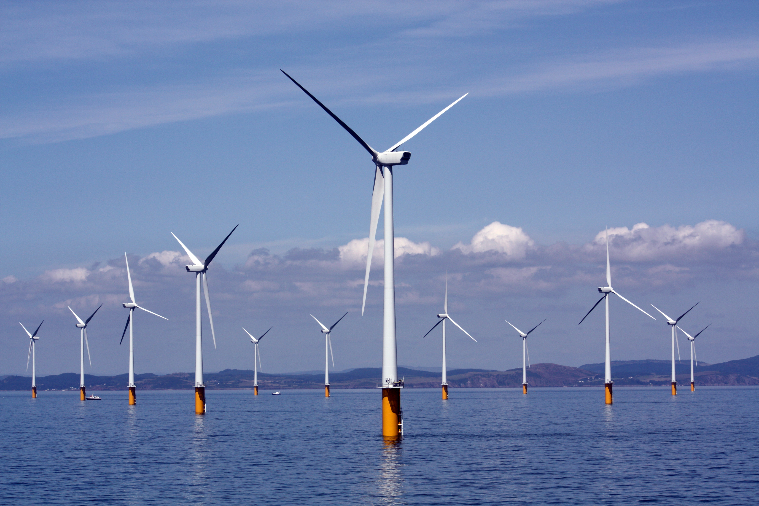
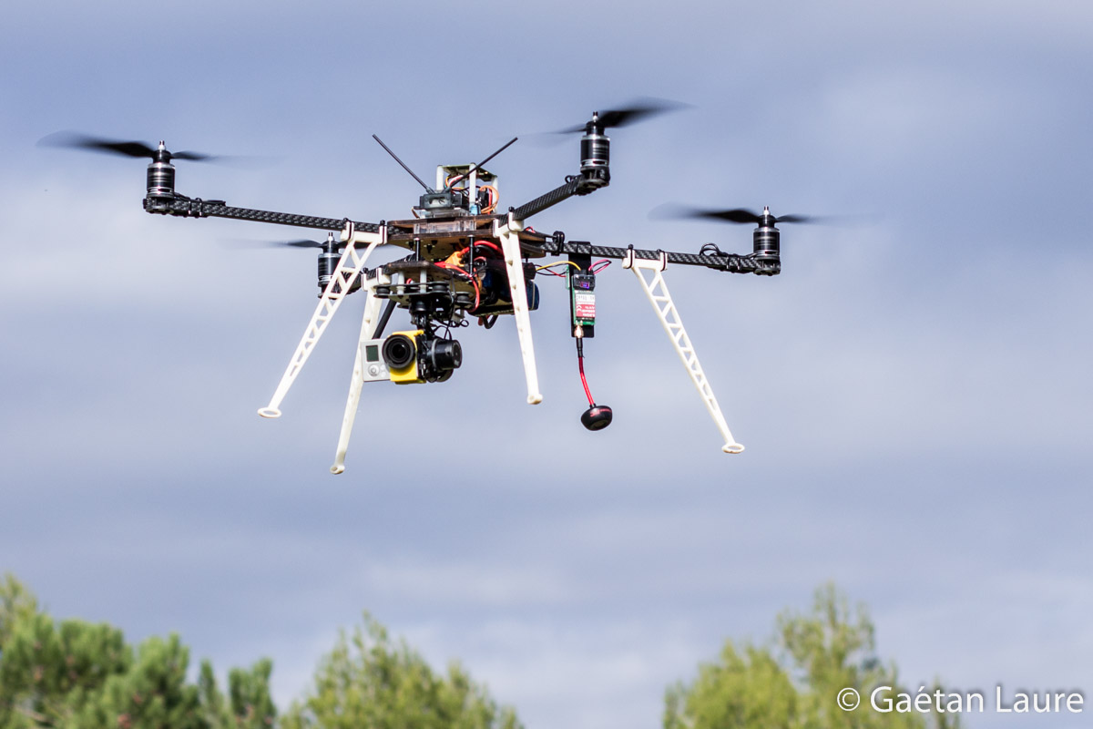
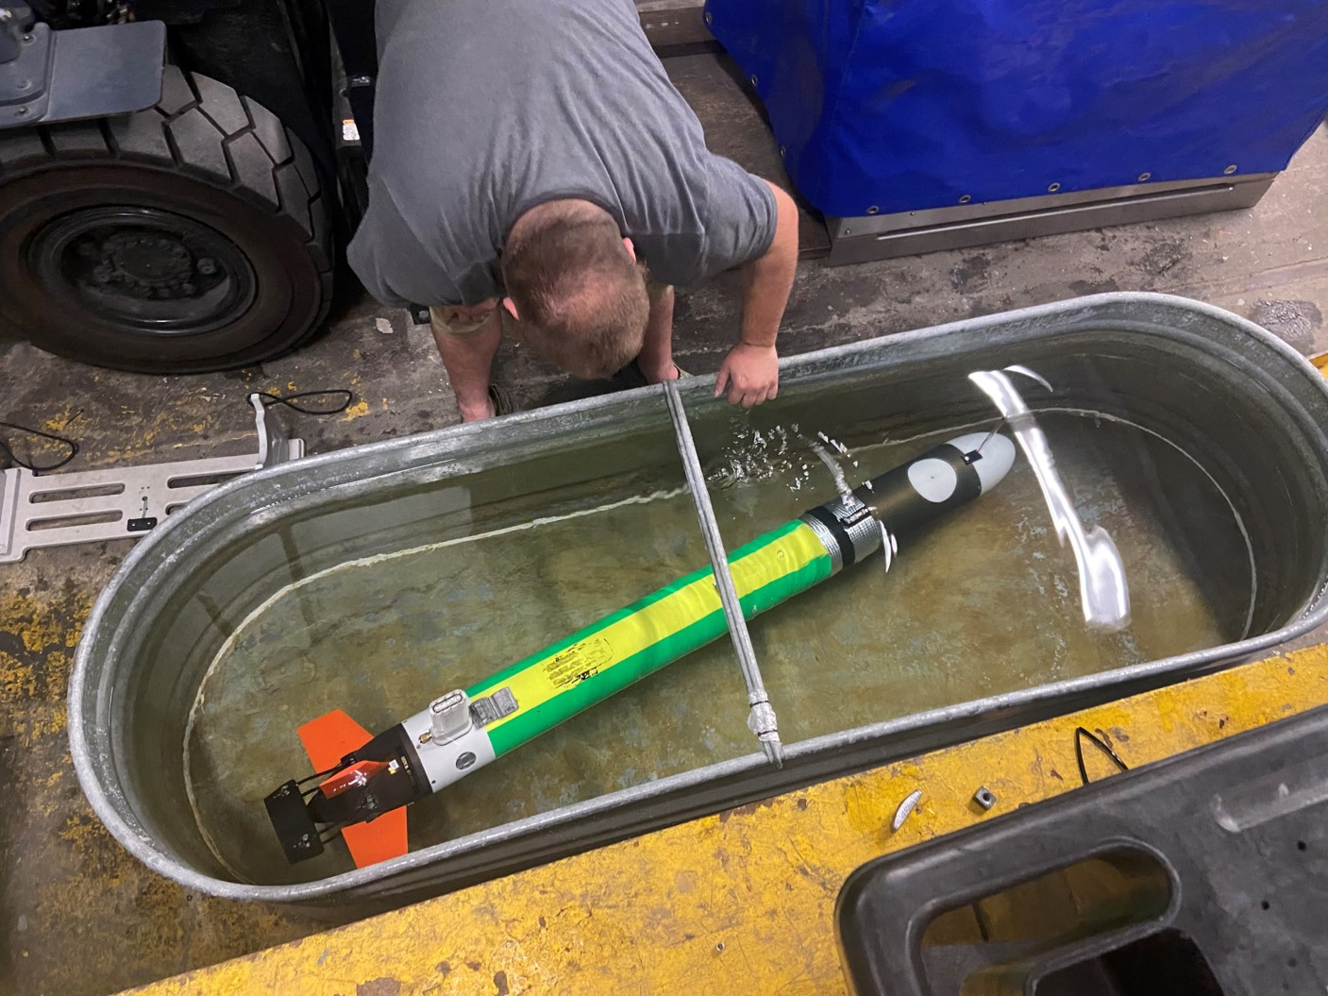
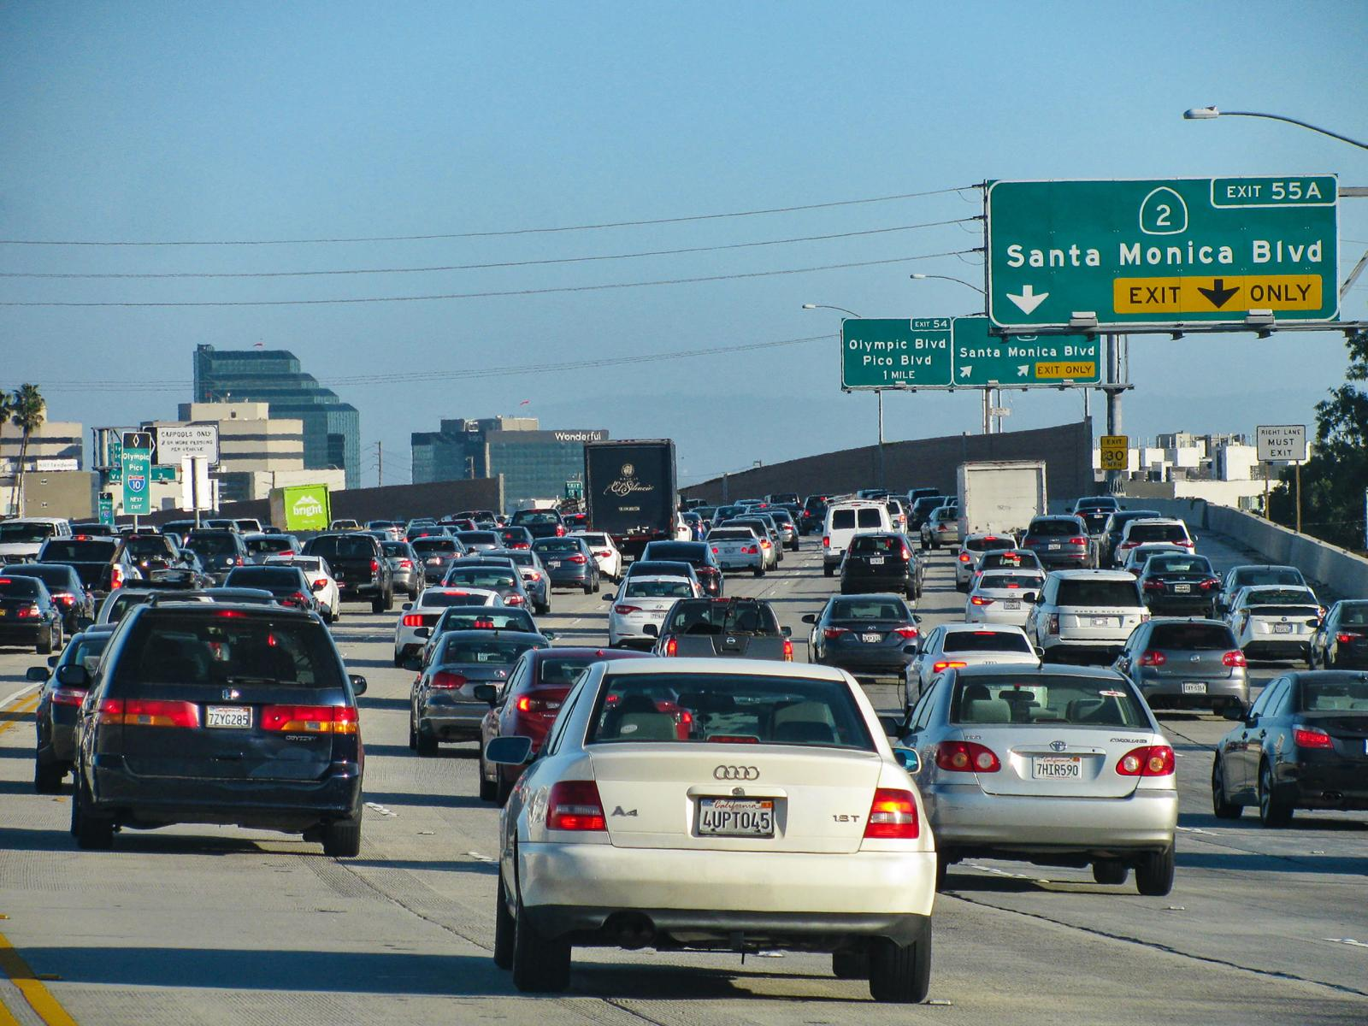
Motivation
Simulations are crucial for many areas of decision-making and scientific discovery
Need: Improve computational efficiency and scalability for heterogenous scientific simulations
Challenges:
Modeling and simulation of complex systems is hard
Optimal control and closed-loop decision-making for complex systems is hard-er
Scientific computing and machine learning tools are fragmented and not easily composable

Slide 3
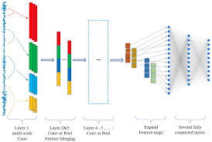
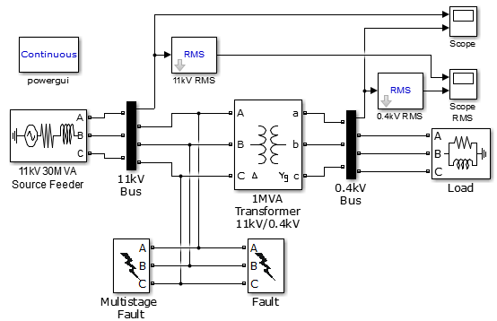
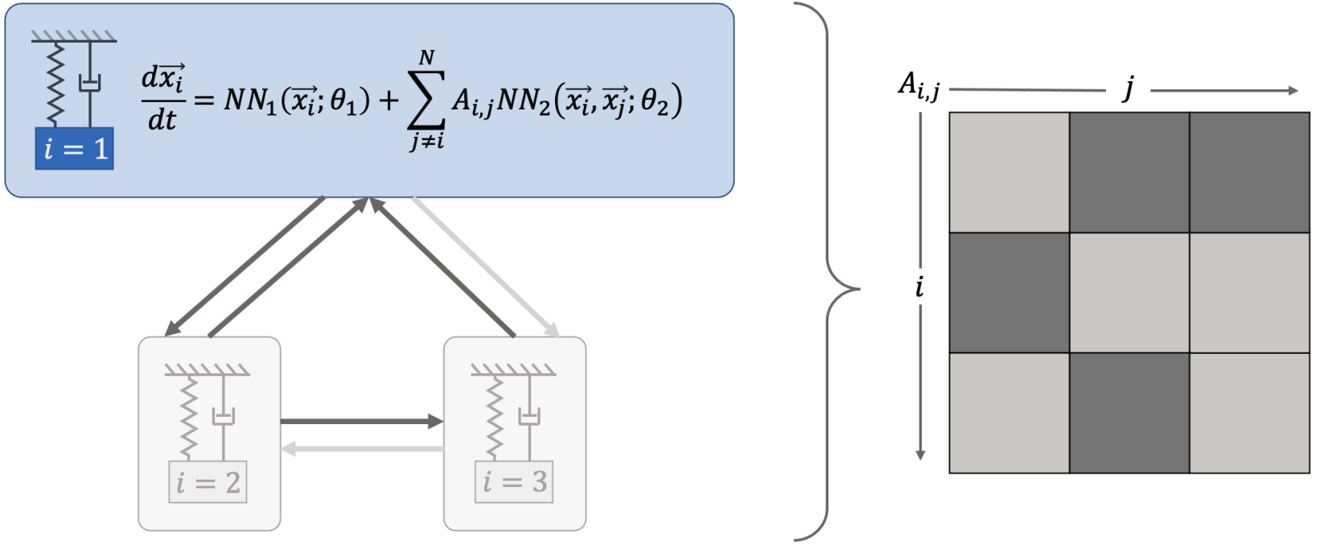
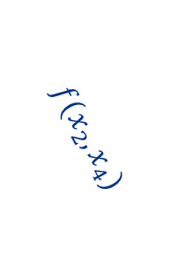
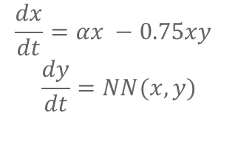

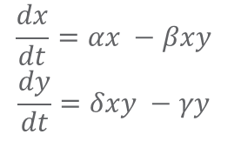
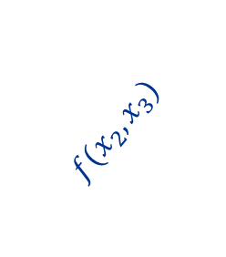
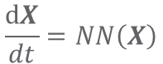
Challenge 1: Heterogenous Modeling Methods
White-box
Gray-box
Black Box
$$\frac{dx}{dt}=αx −βxy$$
$$\frac{dy}{dt}=δxy −γy$$
$$\frac{dx}{dt}=αx −0.75xy$$
$$\frac{dy}{dt}=NN(x,y)$$
$$\frac{dX}{dt}=NN\left(X\right)$$
More domain knowledge
Less domain knowledge
physics-based
networked neural ODEs
neural differential equations
state space models
physics priors
graph neural networks
3
$$f(x_{2},x_{3})$$
$$f(x_{2},x_{1})$$
1
2
$$f(x_{2},x_{4})$$
4

Slide 4

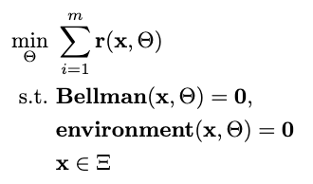

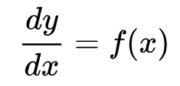

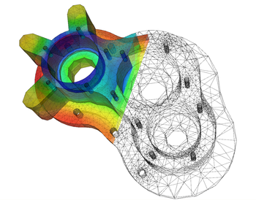
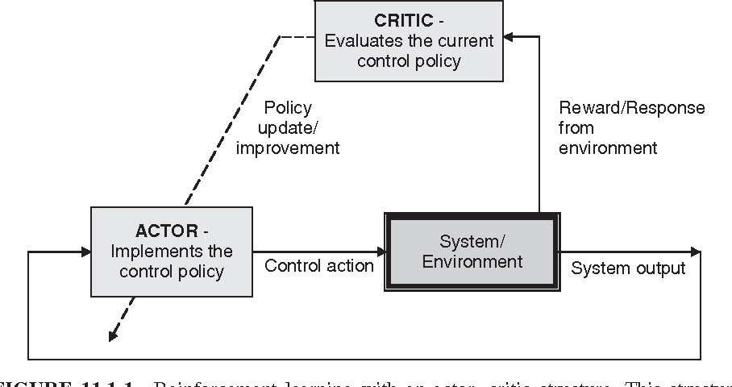

Challenge 2: Heterogenous Solution Methods
Constrained optimization
Differential equations
Supervised Learning
Reinforcement Learning
Requires prior knowledge of objective function and constraints
Requires prior knowledge of the physics to be modeled
Requires large labeled datasets
Requires environment model to sample
More domain knowledge
Less domain knowledge

Slide 5




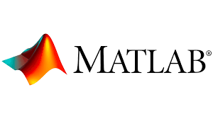
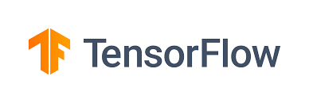



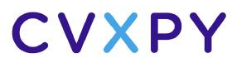


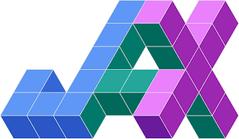



Challenge 3: Heterogenous Solution Tools
Constrained optimization
Differential Equations
Supervised Learning
Reinforcement Learning
More domain knowledge
Less domain knowledge

Slide 6
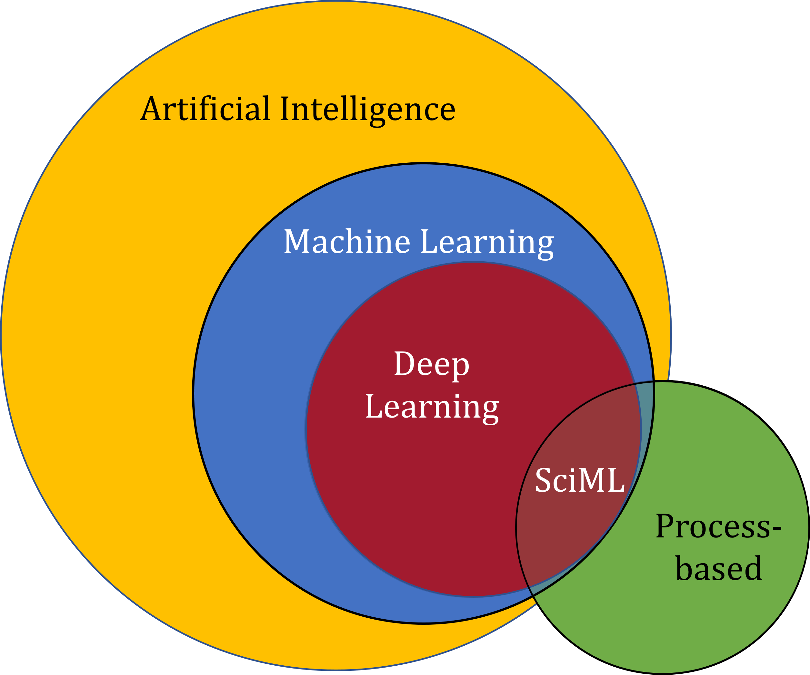
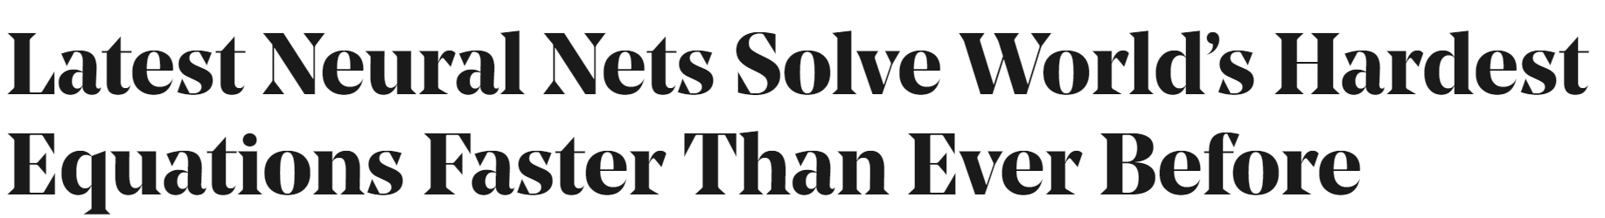

Scientific Machine Learning (SciML)
What?
SciML or Physics-Informed Machine learning (PIML) systematically integrates ML with models and algorithms developed in traditional scientific and engineering domains
Why?
Scientific applications are governed by fundamental principles and physical constraints
Purely data-driven “black box” ML methods cannot satisfy underlying physics
How?
Leverage automatic differentiation to enable learning for modeling, optimization, and control
Image source: https://sciml.wur.nl/reviews/sciml/sciml.html

Slide 7
Selected Scientific Machine Learning Literature
Differentiable Programming
M. Innes, et al., A Differentiable Programming System to Bridge Machine Learning and Scientific Computing, 2019
Learning to Solve (L2S)
M. Raissi, et al., Physics-informed neural networks: A deep learning framework for solving forward and inverse problems involving nonlinear partial differential equations, 2019
Learning to Optimize (L2O)
A. Agrawal, et al., Differentiable Convex Optimization Layers, 2019
P. Donti, et al., DC3: A learning method for optimization with hard constraints, 2021
J. Kotary, et al., End-to-End Constrained Optimization Learning: A Survey, 2021
Learning to Model (L2M)
B. Lusch, et al., Deep learning for universal linear embeddings of nonlinear dynamics, 2018
R. T. Q. Chen, et al., Neural Ordinary Differential Equations, 2019
C. Rackauckas, et al., Universal Differential Equations for Scientific Machine Learning, 2021
Learning to Control (L2C)
B. Amos, et al., Differentiable MPC for End-to-end Planning and Control, 2019
S. East, et al., Infinite-Horizon Differentiable Model Predictive Control, 2020
Y Qiao, et al., Scalable Differentiable Physics for Learning and Control, 2020

Slide 8
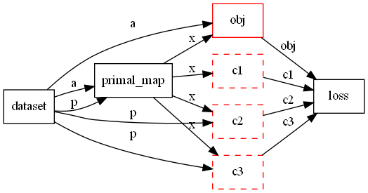
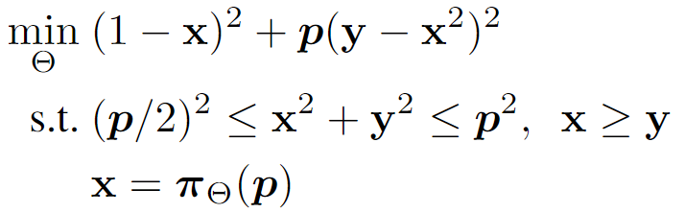
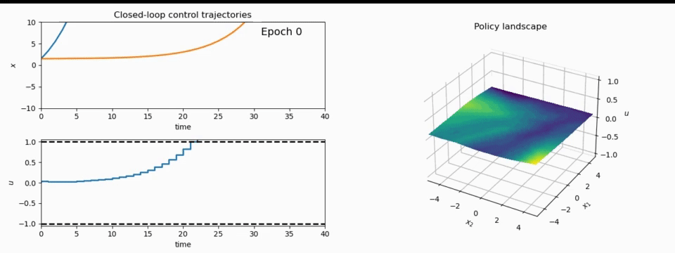
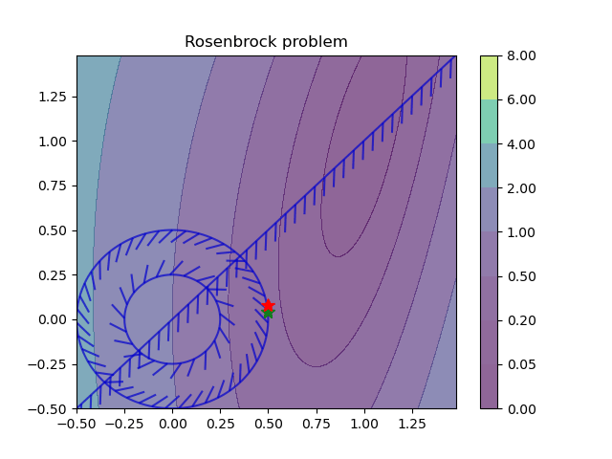
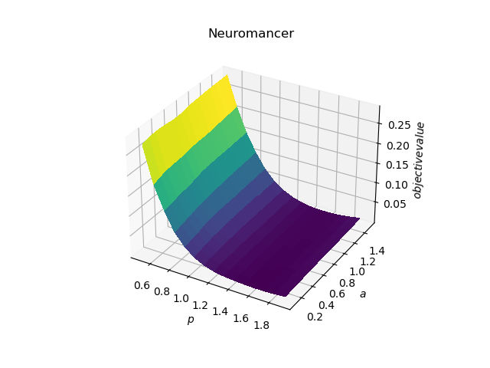
NeuroMANCER: a Scientific Machine Learning Library
1. Mathematical formulation
3. Problem graph
map
2. Python code interface
4. Results
import neuromancer as nm
p = nm.variable(‘p’)
x = nm.variable(‘x’)
y = nm.variable('y’)
obj = ((1-x)**2 + p*(y-x**2)**2).minimize(weight=1.0, name='obj’) c1 = (p/2)**2 <= x**2 + y**2
c2 = x**2 + y**2 <= p**2
c3 = x >= y net = nm.MLP(insize=2, outsize=2, hsizes=[80]*4) map = nm.Node(net, input_keys=['p’], output_keys=[‘x’,‘y’])
loss = nm.PenaltyLoss([obj], [c1, c2, c3]) problem = nm.Problem([map], loss)
optimizer = torch.optim.AdamW(problem.parameters()) trainer = nm.Trainer(problem,data,optimizer)
best_model = trainer.train()

Slide 9
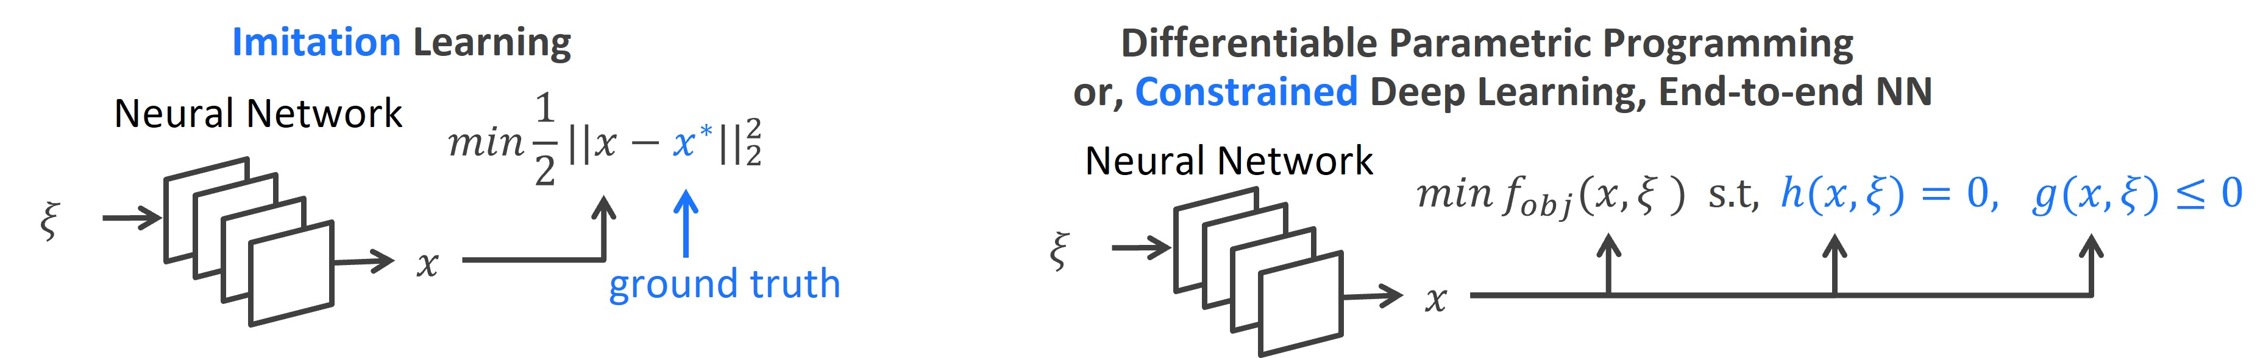
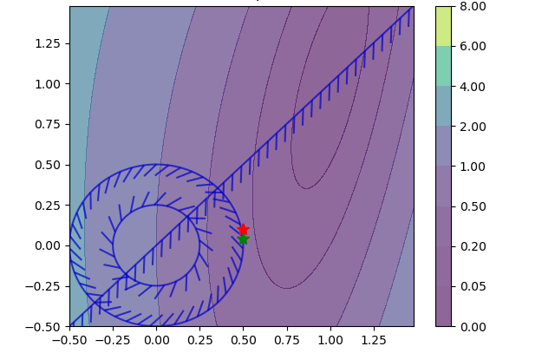
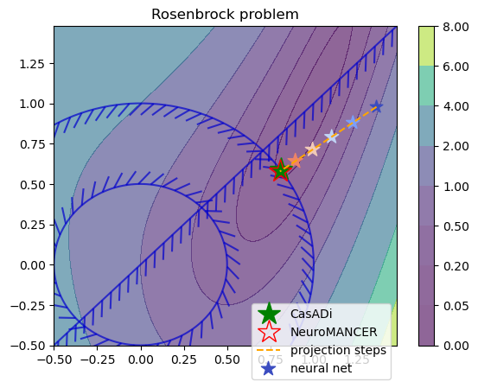
Learning to Optimize in Neuromancer
Training neural networks as explicit solutions
Feasibility restoration with implicit layers

Slide 10
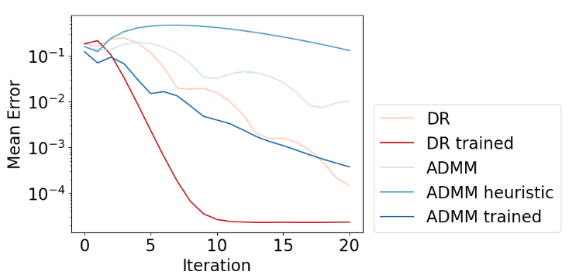
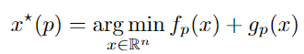
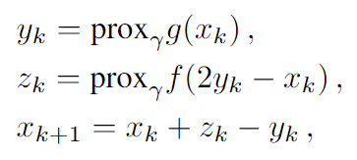
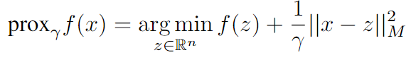
Metric Learning to Accelerate Convergence of Operator Splitting Methods
Parametric programming setting:
Douglas-Rachford splitting (DR) algorithm:
We can accelerate convergence of DR and ADMM algorithms via end-to-end metric learning.
Idea: Train neural network to optimize the metric as a function of problem parameters:
Ethan King, James Kotary, Ferdinando Fioretto, Jan Drgona, Metric Learning to Accelerate Convergence of Operator Splitting Methods for Differentiable Parametric Programming, Under review for CDC 2024.

Slide 11
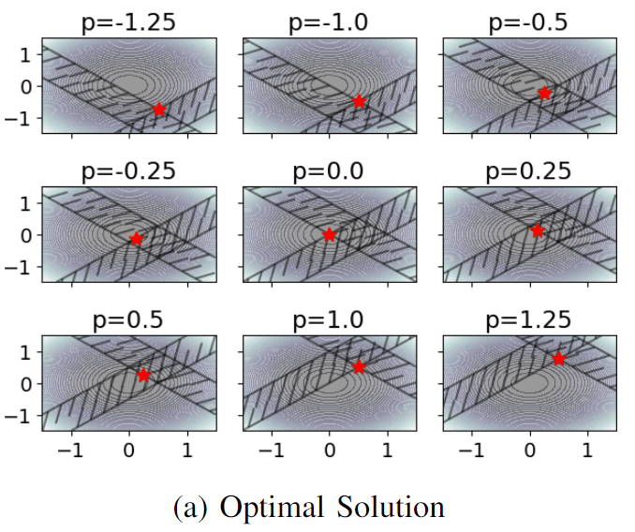
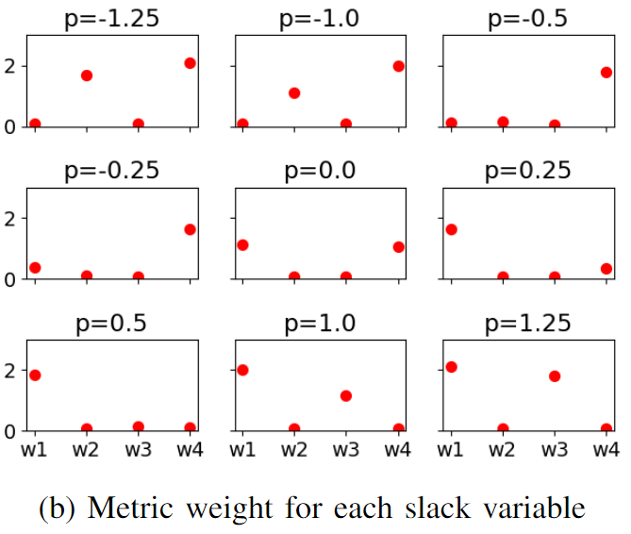
Metric Learning is a Form of Active Set Prediction
Ethan King, James Kotary, Ferdinando Fioretto, Jan Drgona, Metric Learning to Accelerate Convergence of Operator Splitting Methods for Differentiable Parametric Programming, Under review for CDC 2024.

Slide 12
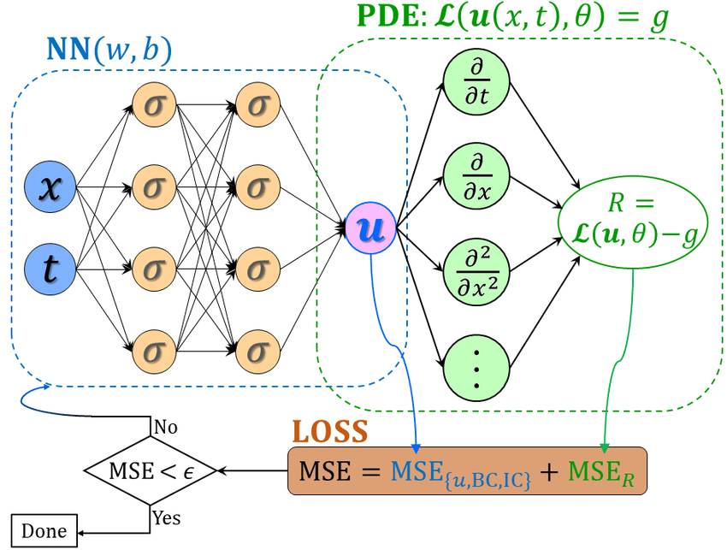
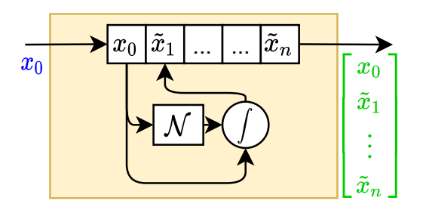
Learning to Model in Neuromancer
Component-based Physics-informed Machine Learning
Physics-Informed Neural Networks
Networked Dynamical systems
Neural differential equations

Slide 13
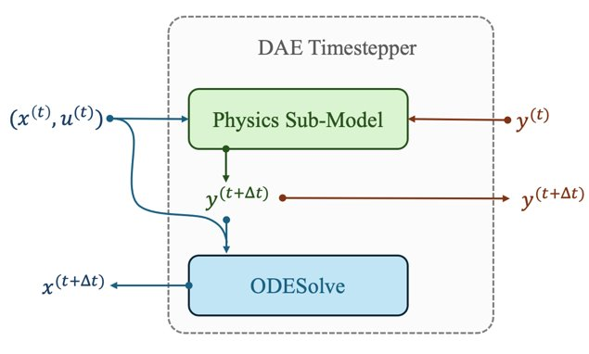
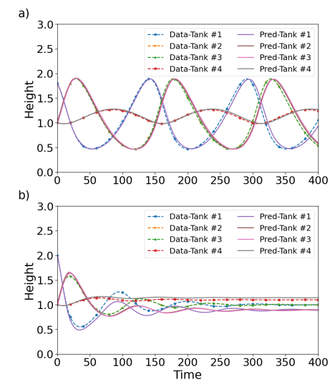
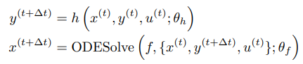
Neural Differential Algebraic Equations
Trained with physics-informed loss function:
Time stepper architecture is inspired by Lie-Trotter operator splitting method:
Inverse modeling, robustness to noise and, out of distribution generalization.
J. Koch, M. Shapiro, H. Sharma, D. Vrabie, J. Drgona, Neural Differential Algebraic Equations, arXiv:2403.12938, 2024.

Slide 14
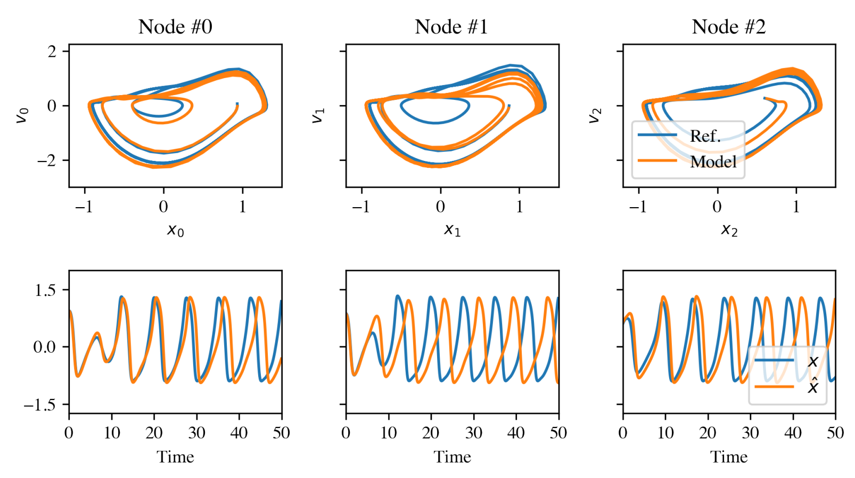
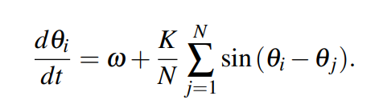
Networked Dynamical Systems via Universal Differential Equations (UDEs)
Network of unknown oscillators
Coupling adjacency
Generalization of learned dynamics on never-seen network topology.
Ground truth Kuramoto system:
James Koch, et al., Structural Inference of Networked Dynamical Systems with Universal Differential Equations, Chaos: An interdisciplinary Journal of Nonlinear Science, doi.org/10.1063/5.0109093, 2023

Slide 15
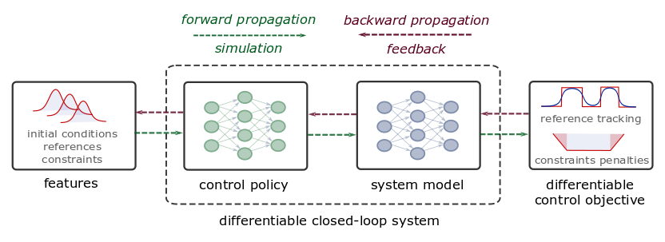
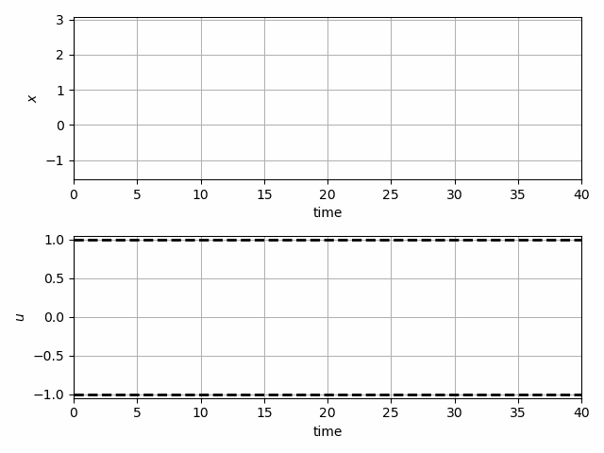
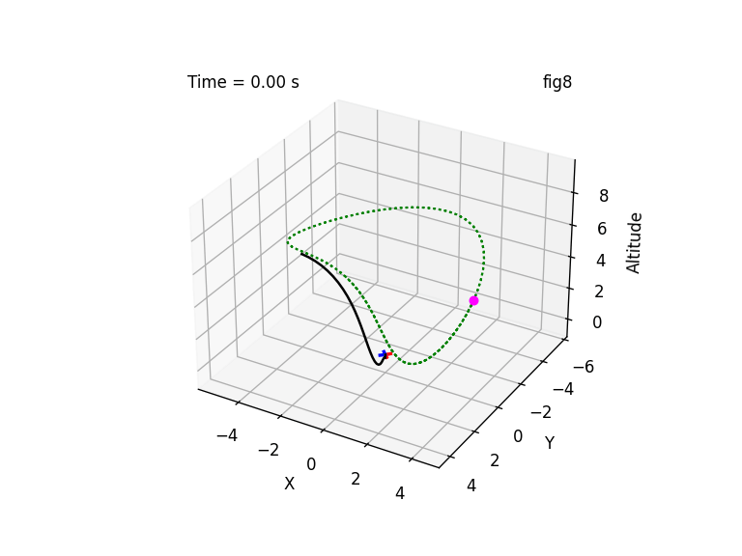
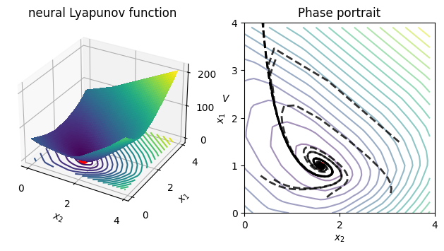
Learning to Control in Neuromancer
Differentiable predictive control
Learning stabilizing controllers
Trajectory optimization and obstacle avoidance
Learning Energy Functions

Slide 16
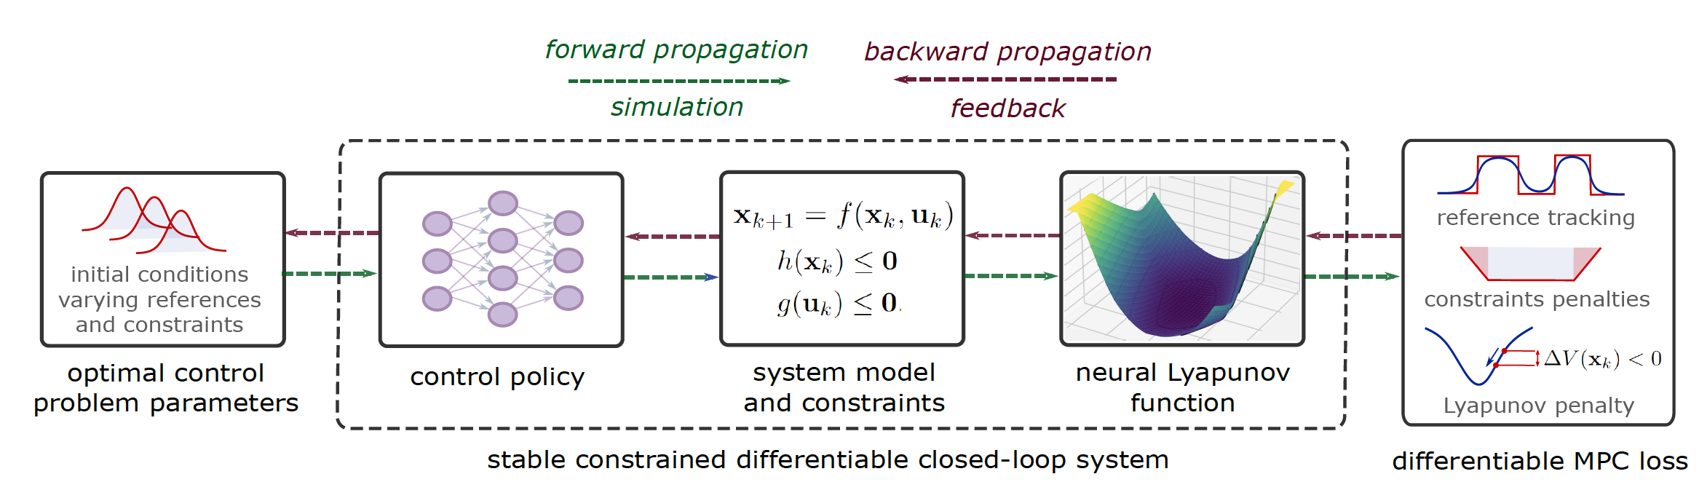
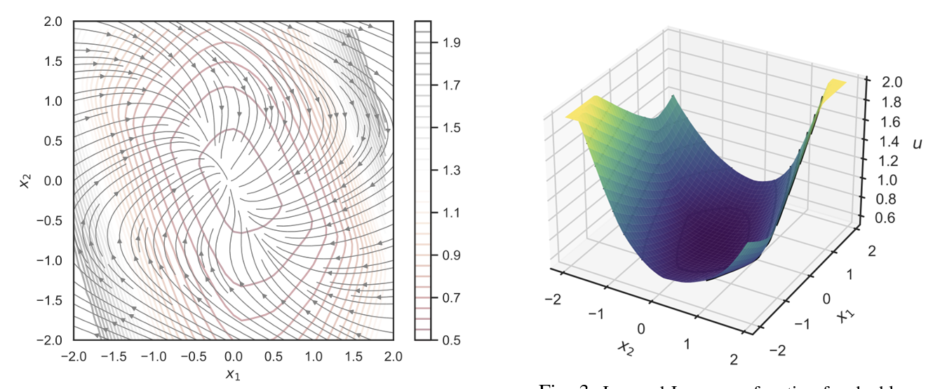
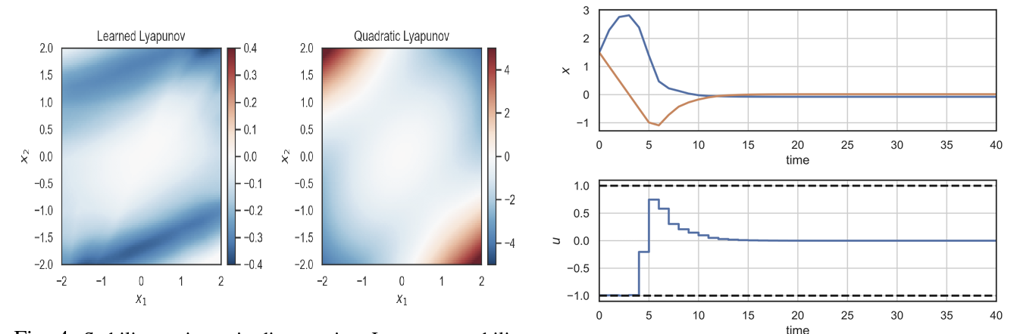
Learning Stable Policies with Neural Lyapunov Functions
Sayak Mukherjee, Ján Drgoňa, Aaron Tuor, Mahantesh Halappanavar, Draguna Vrabie, Neural Lyapunov Differentiable Predictive Control, Conference on Decision and Control (CDC), 2022

Slide 17



Learning to Control Building Energy Systems
Architectures
Neural state space dynamics model
MLP control policy architecture
Results
Multi-input multi-output system dynamics
Dynamic economic control objective
Parametric constraints
Jan Drgona, Aaron Tuor, Elliott Skomski, Soumya Vasisht, Draguna Vrabie, Deep Learning Explicit Differentiable Predictive Control Laws for Buildings, IFAC NMPC 2021

Slide 18


Learning to Solve Dynamic Economic Dispatch
Problem: Current dispatch processes do not incorporate system dynamics concerns. Incorporating dynamics in economic dispatch is too complex and time-consuming.
Architectures
Koopman dynamics model
CNN control policy
Solution: Machine-learning based dynamics-aware dispatch. Learn system dynamics and control policies for faster assessment.
Results
5 orders of magnitude speed-up
Near optimal performance
Ethan King, Ján Drgoňa, Aaron Tuor, Shrirang Abhyankar, Craig Bakker, Arnab Bhattacharya, Draguna Vrabie, Koopman-based Differentiable Predictive Control for the Dynamics-Aware Economic Dispatch Problem, 2022 American Control Conference

Slide 19
Edge Deployment of Differentiable Predictive Control
Flexy-Air system sketch with Raspberry-Pi controller
Jan Drgona, Karol Kis, Aaron Tuor, Draguna Vrabie, Martin Klauco, Differentiable Predictive Control: An MPC Alternative for Unknown Nonlinear Systems using Constrained Deep Learning; Journal of Process Control, 2022
Proof of concept for AI on the edge platform.

Slide 20


Learning to Control for Robotic Systems
J. Viljoen, et al., Differentiable Predictive Control for Robotics: A Data-Driven Predictive Safety Filter Approach, under review at IROS, 2024.

Slide 21

















Funding & Partnerships
Developed by internal investments …
… and now supporting a portfolio of sponsor-funded projects worth over $20M
Strategic industrial partnerships and collaborations
Notes:
Dynamic decarbonization through autonomous physics-centric deep learning and optimization of building operations - DOE BTO $1,000K total budget
Advancing Market-Ready Building Energy Management by Cost-Effective Differentiable Predictive Control - DOE BTO - $5,440K total budget
Data-Driven Decision Control for Complex Systems (DnC2S) - DOE ASCR - $1,200K total budget
AutonomIA – ARPA-e - $5,891K total budget
Addressing Challenges in Energy: Floating Wind in a Changing Climate (ACE-FWICC)- WTO, ASCR - $5,000K total budget
(MOLUcQ) Uncertainty Quantification for Multifidelity Operator Learning, ASCR - $1,650K total budget

Slide 22









Open-Source Success
github.com/pnnl/neuromancer
PyTorch SciML toolkit
User-friendly API
Interactive tutorials
Community engagement
NeuroMANCER
VOLTTRON
HyperNetX
Core Development Team
Ján Drgoňa
Diff Predictive Control
Aaron Tuor
Deep Learning
Madelyn Shapiro
Deep Learning
Rahul Birmiwal
Software Development
James Koch
Dynamical Systems
Draguna Vrabie
Predictive Control

Slide 23



NeuroMANCER
Open-source scientific machine learning (SciML) toolbox in Pytorch integrating deep learning, constrained optimization, and physics-based modeling
Learning to optimize
Learning to control
Nonlinear system identification
Physics-informed neural networks
github.com/pnnl/neuromancer
www.youtube.com/@neuromancer_SciML
drgona.github.io

Slide 24
Differentiable Programming
Differentiable Programming
M. Innes, et al., A Differentiable Programming System to Bridge Machine Learning and Scientific Computing, 2019
Physics-informed Neural Networks
M. Raissi, et al., Physics-informed neural networks: A deep learning framework for solving forward and inverse problems involving nonlinear partial differential equations, 2019
Neural Differential Equations
R. T. Q. Chen, et al., Neural Ordinary Differential Equations, 2019
C. Rackauckas , et al., Universal Differential Equations for Scientific Machine Learning, 2021
Differentiable Optimization
A. Agrawal, et al., Differentiable Convex Optimization Layers, 2019
P. Donti, et al., DC3: A learning method for optimization with hard constraints, 2021
S. Gould, et al., Deep Declarative Networks: A New Hope, 2020
J. Kotary, et al., End-to-End Constrained Optimization Learning: A Survey, 2021
Differentiable Control
B. Amos, et al., Differentiable MPC for End-to-end Planning and Control, 2019
S. East, et al., Infinite-Horizon Differentiable Model Predictive Control, 2020
A. Agrawal, et al., Learning Convex Optimization Control Policies, 2020.

Slide 25

Differentiable Parametric Programming: Generalization of Physics-informed Neural Networks
Problem formulation:

Slide 26
Differentiable Parametric Programming: Generalization of Physics-informed Neural Networks
Objective function
Problem formulation:
Constraints
Primal optimizers
Scenarios
Solution map
Parameters

Slide 27

Differentiable Parametric Programming: Generalization of Physics-informed Neural Networks
Objective function
Problem formulation:
Constraints
Primal optimizers
Scenarios
Solution map
Parameters
Lagrangian form:
Constraints penalties
Gradient-based optimization based on AD

